Slide 1
CSE322
PARSING: Top-Down and Bottom-Up Parsing
LL(K) and LR(K) grammar
Lecture #35

Slide 2
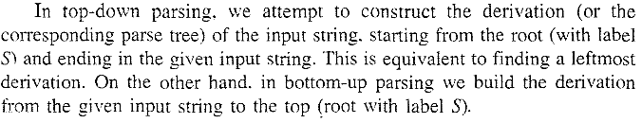
Parsing
Parsing is process of splitting a sentence into words.
Two types of Parsing
    Top Down
    Bottom Up
    In Formal Language we have :-

Slide 3
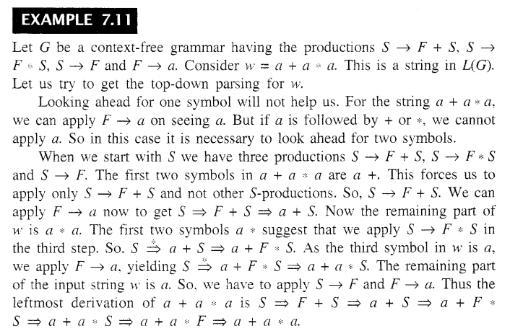

Top Down Parsing

Slide 4
Remember Parse Trees
Parse tree for S ⇒ AbbcBa ⇒* cbbccccaBca
⇒ cbbccccacca
S
A
b
b
c
a
B
c
A
c
c
a
B
c
c
c

Slide 5
LL(K) Grammar and Properties
A Grammar G having Property(by looking ahead for K symbols we derive a given input string in L(G) is called an LL(K) Grammar.
Example:-
Let G = ({S, A, B}, {a, b} , P , S) where P consists of S aAB, S bBA, A bS, A a, B aS,
B b , w= abbbab is in L(G)

Slide 6

LR(K) Grammar
LR(K) stands for left to right scan of the input string producing a rightmost derivation using k symbol look ahead on the input string.

Slide 7
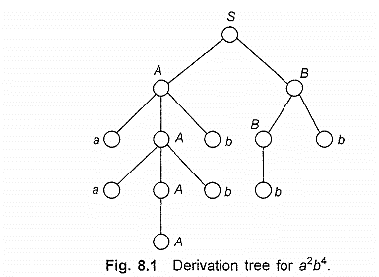

Slide 8
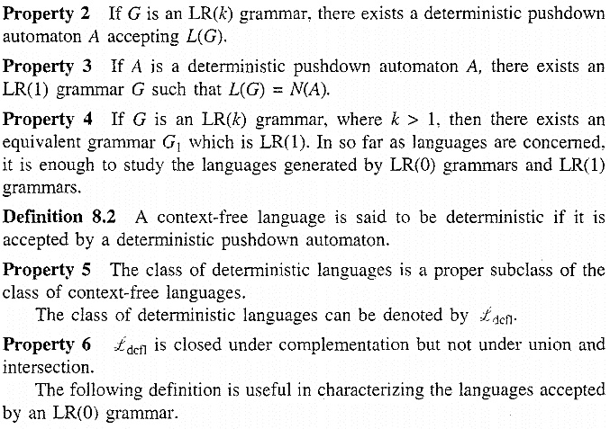
Properties of LR(K)

Slide 9
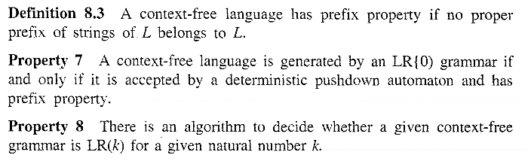

Slide 10
Parsing Ambiguity
If for a input string two or more tree can be drawn then the parsing is ambiguous.

